Slide 1

AI and Machine Learning for IoT Big Data

Slide 2
Dissecting Deep Learning

Slide 3
Lecture 5: Dissecting Deep Learning
Review of Deep Learning
Example: Plant Disease Detection
Images as input
Network structure
Activations
Transfer learning
Results, discussion

Slide 4
What is (“shallow”) Learning?
We create “features” from the input data: for instance, “formants” for speech, “texture” for images, … (based on domain knowledge)
Learning modifies all layers
Use one or a few “hidden” layers
Learning can be done with relatively little data
Learning is fairly quick
Notes:
A lot of research have been done in the past to design and refine feature generation
Neural Networks have been used for decades; the biggest change is the abundance of processing power

Slide 5
Some feature extraction methods
Images: texture statistics contours
Voice: spectrum (FFT) cepstrum formant structure

Slide 6
What is Deep Learning?
Features are learned, not extracted by human-made algorithms
Learning proceeds by layers, creating feature-generating structure for the input
Use a lot of layers
Use a lot of data
Learning is computationally intensive
Notes:
Point out the similarity with sensory information processing in the brain

Slide 7
Plant Disease Detection
Cultivated plants are attacked by pests etc.
Farmers in developing countries need help
Detection of diseases is difficult
Agronomical knowledge is rare, expensive Basic idea:
Collect images of healthy and diseased plants
Train AI to recognize diseases
Notes:
What are the choices of a farmer observing decreased productivity or quality?
Use traditional methods
Ask help from fellow farmers
Ask help from agronomists
Search for information in books or on the Internet
Which of these are available in developing vs. developed countries?

Slide 8
Reason for Deep Learning (DL)
No clear theoretical foundation for feature selection, for disease detection in plant images
However, many samples can be collected, satisfying the requirements for DL
The huge training dataset and computational load can be handled by Big Data technologies
The resulting AI classifier can be executed on smaller computers (mobile phones etc.)
Notes:
Motivating example: the success of DL methods for human face recognition (Facebook, photo albums etc.)

Slide 9
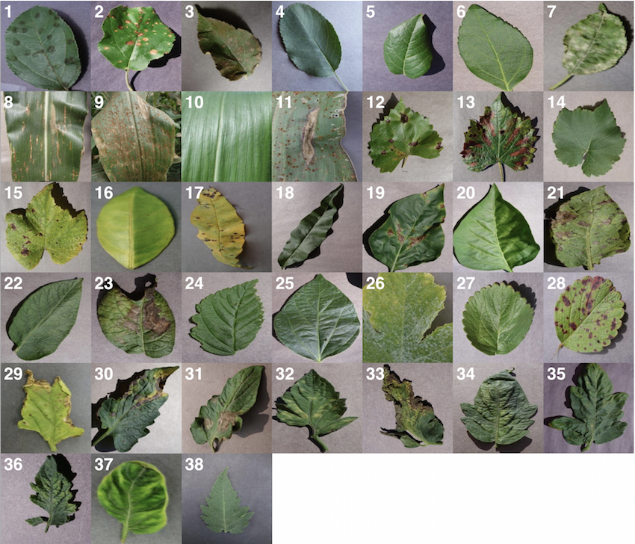
Sample images of various plant diseases from PlantVillage
Credits: Using Deep Learning for Image-Based Plant Disease Detection
Sharada Prasanna Mohanty1,2, David Hughes3,4,5, and Marcel Salathé1,2,6
https://arxiv.org/pdf/1604.03169.pdf

Slide 10
Discussion
What are the apparent characteristics of plant disease in the images?
How would you create an operational description for a human? Like e.g. “look for whitish spots near the stem” etc.
How would you program the descriptions as executable feature extraction?
Notes:
Assignment: download sample image sets from PlantVillage; try to give a description of the disease symptoms

Slide 11
Deep Learning network
Structure: Convolutional Neural Network
Modeled on the mammal early vision system
Intermediate layers have receptive fields
Connections are replicated
Features are generated automatically

Slide 12
Typical convolutional neural network
Credit: Aphex34 (https://commons.wikimedia.org/wiki/File:Typical_cnn.png), https://creativecommons.org/licenses/by-sa/4.0/legalcode
Notes:
Explain convolution
Explain subsampling
Discuss why there are several levels

Slide 13

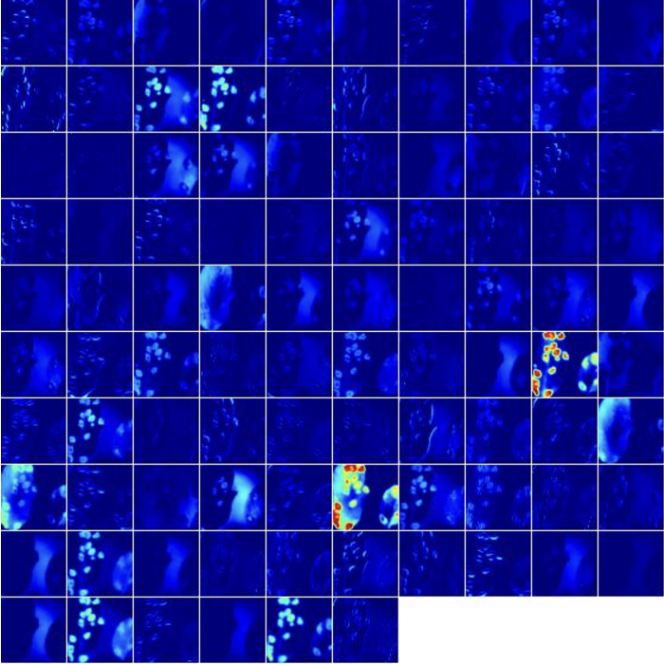
Activations in intermediate layer
Credits: Using Deep Learning for Image-Based Plant Disease Detection
Sharada Prasanna Mohanty1,2, David Hughes3,4,5, and Marcel Salathé1,2,6
https://arxiv.org/pdf/1604.03169.pdf
Notes:
Explain activation

Slide 14
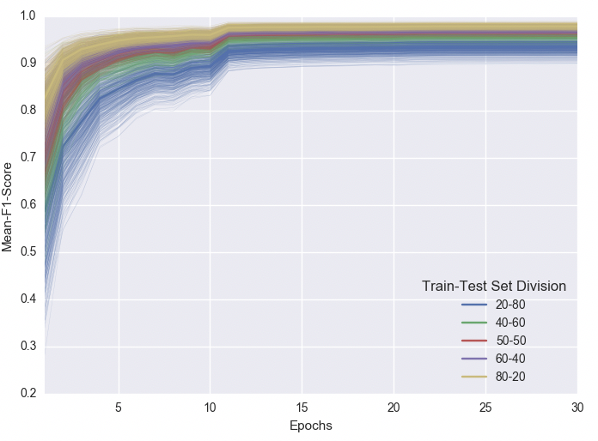
Progress of learning through 30 epochs
Credits: Using Deep Learning for Image-Based Plant Disease Detection
Sharada Prasanna Mohanty1,2, David Hughes3,4,5, and Marcel Salathé1,2,6
https://arxiv.org/pdf/1604.03169.pdf

Slide 15
Feature Transfer
An efficient trick for DL: domain-specific feature extraction shared between tasks
Train a DL network properly, then copy the input layers into another DL network
Most useful when:
we have a task with only a few data points
we have other tasks in the same domain with lots of available data

Slide 16
Transfer learning: re-use the trained feature maps
TASK 1
TASK 2
Credit: Aphex34 (https://commons.wikimedia.org/wiki/File:Typical_cnn.png), https://creativecommons.org/licenses/by-sa/4.0/legalcode

Slide 17
Typical usage of Deep Learning
Well suited to processing of natural data (images, sounds, language, weather)
Can be used to create robust processors (autonomous cars, surveillance)
Enables the transfer of internal representations among AI systems
Many variants, designed for specific tasks (CDBN, DSN, TDSN, DPCN, …)

